Slide 1

Airline Tweets NLP
Using Streamlit app and ExpertAi to find sentiment Analysis of Airlines tweets.
Created by:
Abid Ali Awan

Slide 2

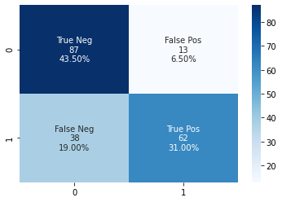
ExpertAI NLP
Expert.ai Edge Natural Language API.
Edge NLP was used to get sentiments, keywords, and entity detection.
Tweets From Airline DataSet was used to predict emotions of users.
Experiments were done on Kaggle Kernal Expert.Ai Sentimental 😆 | Kaggle.

Slide 3

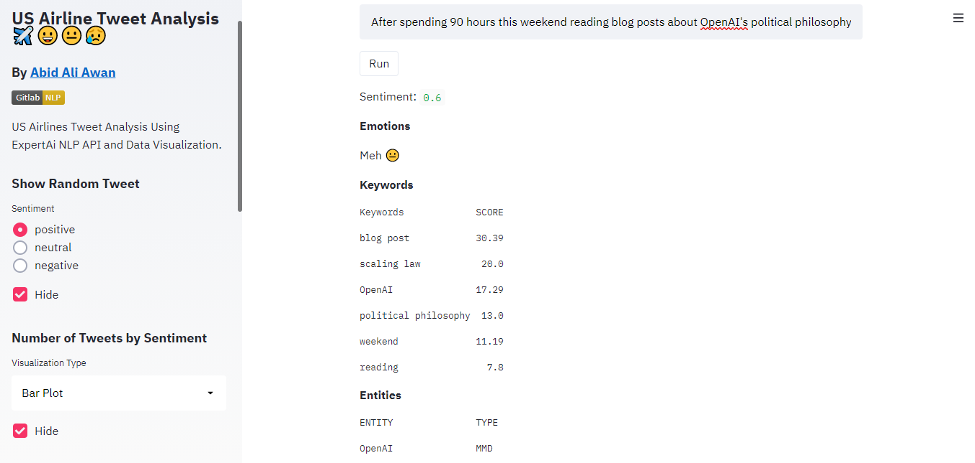
Streamlit WebApp
Interactive Text to Sentiment Prediction.
Random Tweets related to specific Sentiment.
Display Data Visualization.
Using Time slider to see geo location of users.
Airline Companies Analysis.
Word Cloud.

Slide 4
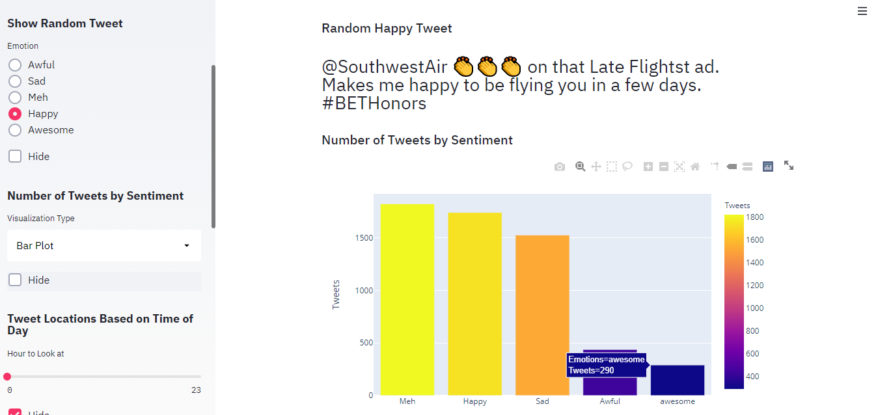
Experimental App
More Features Added using Expert Ai
Whole Data Set was used for predicting Emotions.
Emotions were added by segmenting Sentimental Score.

Slide 5
Thank you
More Feature will be added with time
Relation extraction
Deep linguistic analysis
Document classification
Information extraction

